Slide 1


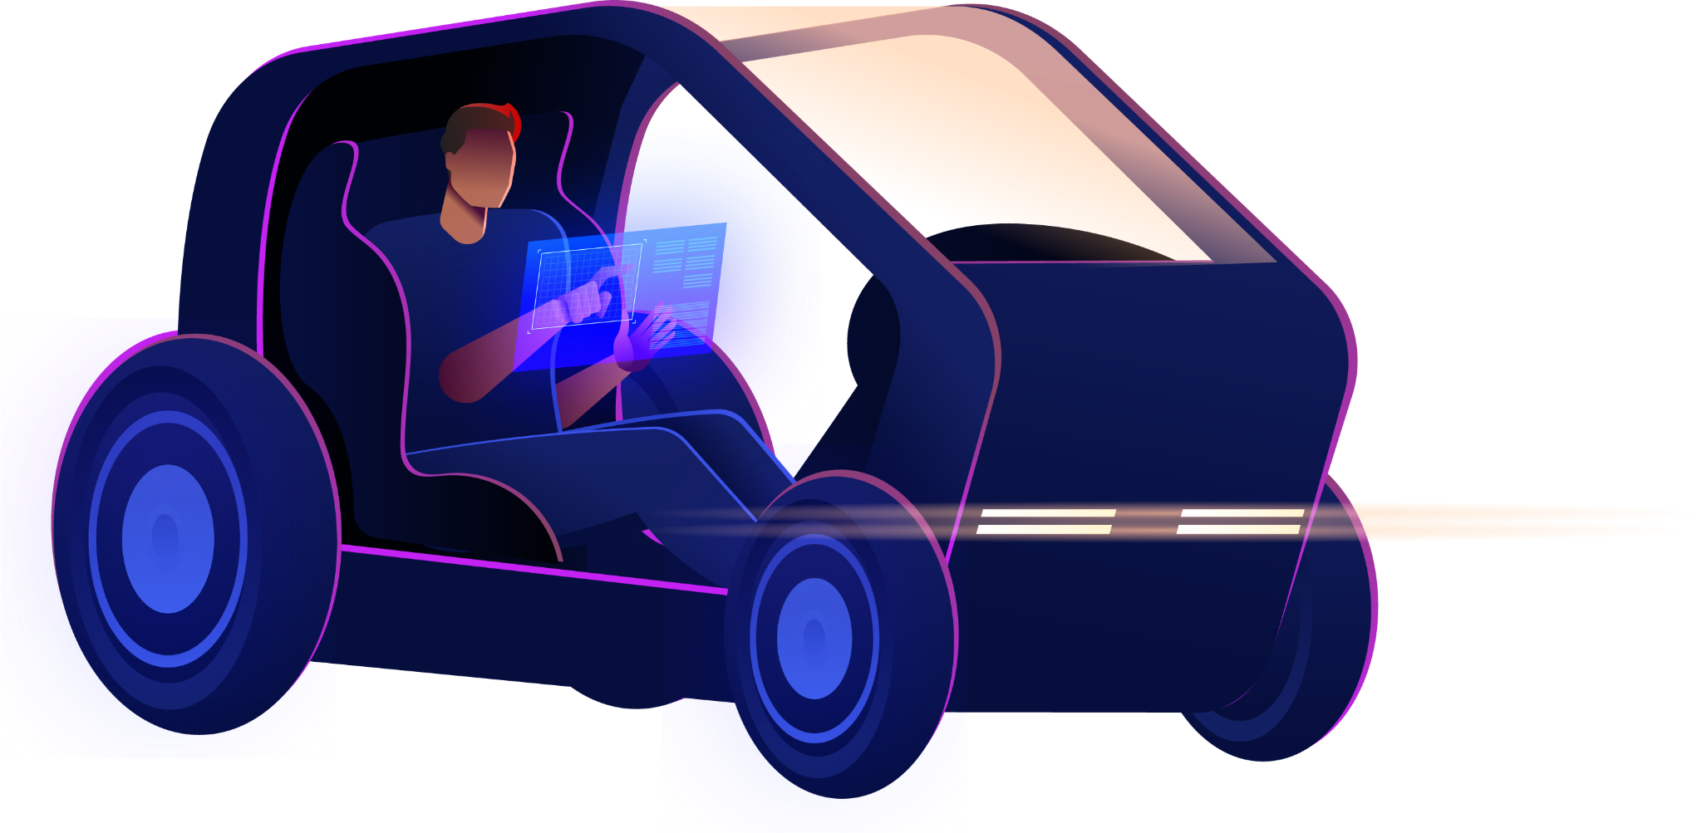


Real-Time Object Detection for Autonomous Vehicles
DEPI Final Project
Here is where your presentation begins

Slide 2

Our Team
Elham Hamed Mahmoud
Mennatullah Yasser Nabile
Mohamed Hisham Anwar

Slide 3
Table of contents
01
04
02
05
Introduction
Milestone 2
Milestone 1
Milestone 3

Slide 4



01
Introduction

Slide 5
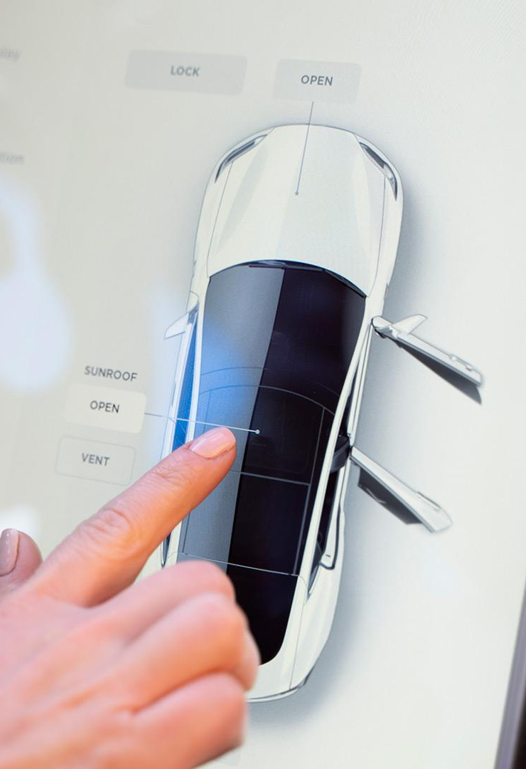

Introduction
Real-time object detection is essential for self-driving cars to perceive and comprehend their environment. This technology is essential to safety and decision-making because it can recognize and locate objects such as vehicles, pedestrians, and traffic signs. It allows for quick, precise scene analysis using deep learning and computer vision, which is similar to human vision but quicker and more dependable.

Slide 6
02
Milestone 1 Data Collection, Exploration, and Preprocessing

Slide 7
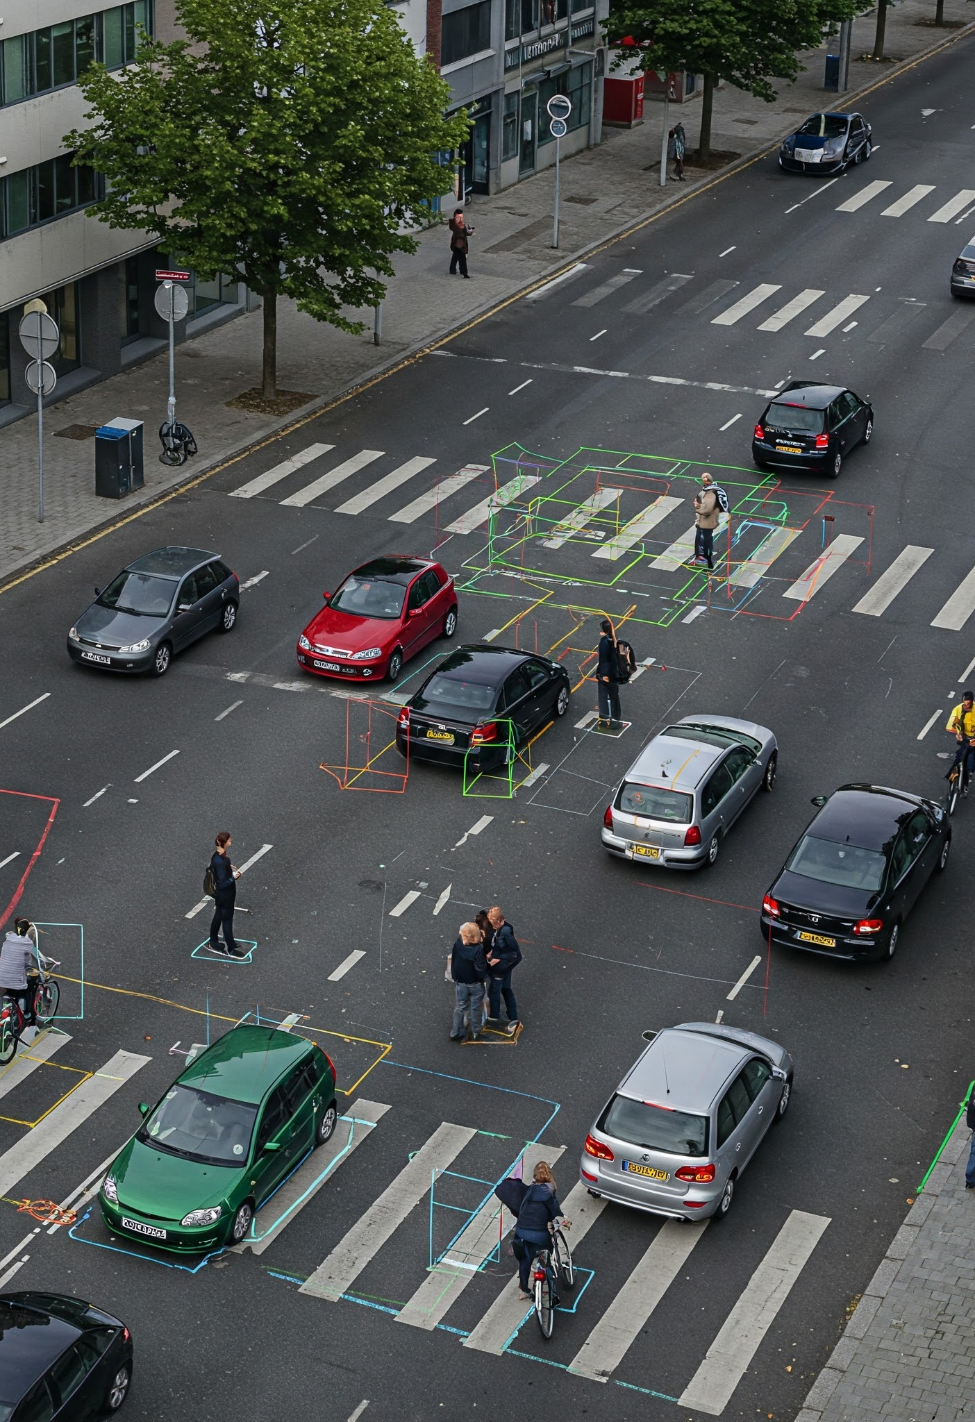
KITTI dataset
The KITTI dataset is a large-scale benchmark used extensively in autonomous driving research. It was collected using a vehicle equipped with multiple sensors, including stereo cameras, RGB cameras, LiDAR, and GPS/IMU, in the city of Karlsruhe, Germany
Object Detection Classes
(Car-Van-Truck-Pedestrian-Cyclist-Person-Tram-Misc)

Slide 8
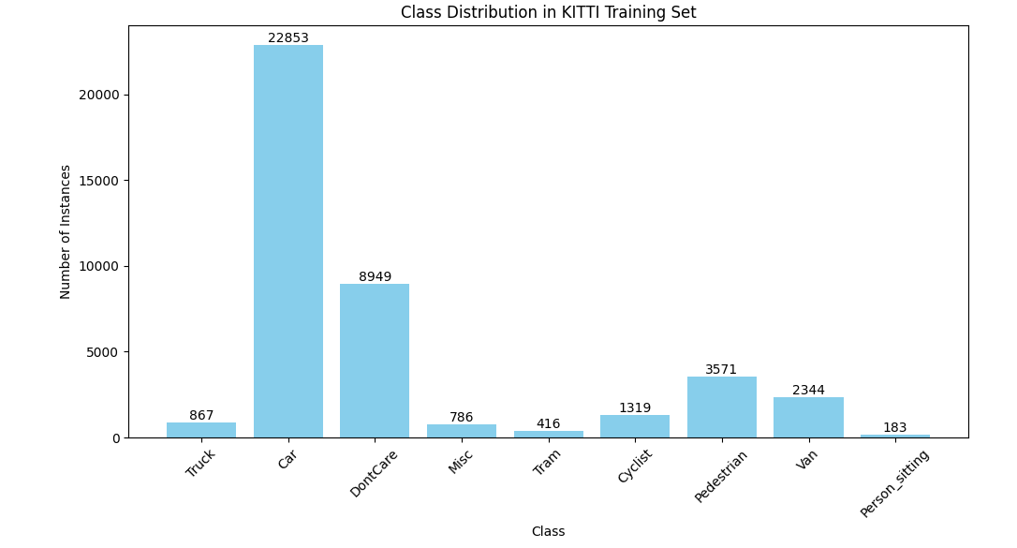
Data Exploration

Slide 9
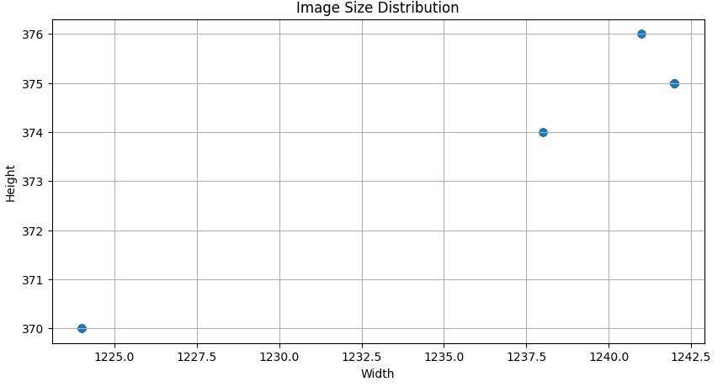
Image resolution

Slide 10
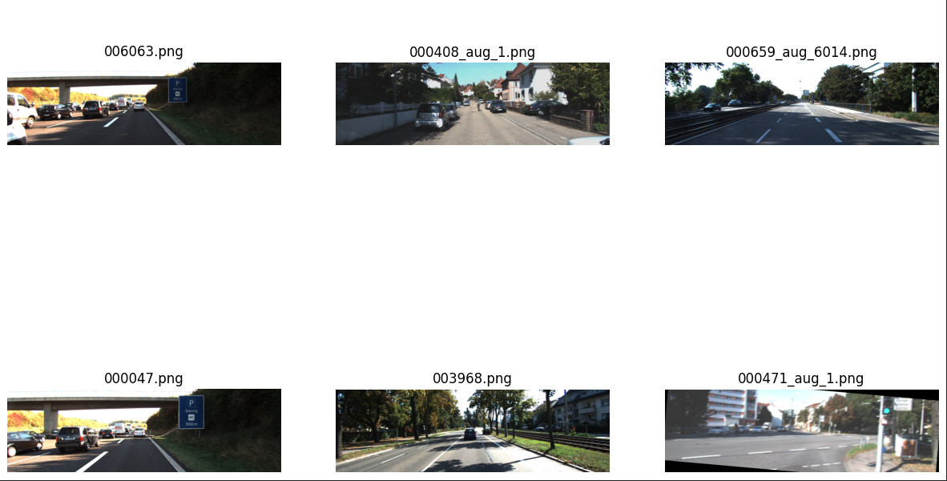
Environmental Diversity in the KITTI Dataset

Slide 11
Preprocessing (Data Augmentation)
Definition
Techniques used to artificially expand and diversify training data by applying transformations like flipping, rotation, and noise.
Common Techniques in Computer Vision
Flipping
Rotation
Scaling & Cropping
Translation
Benefit
Reduce Overfitting
Improves generalization

Slide 12
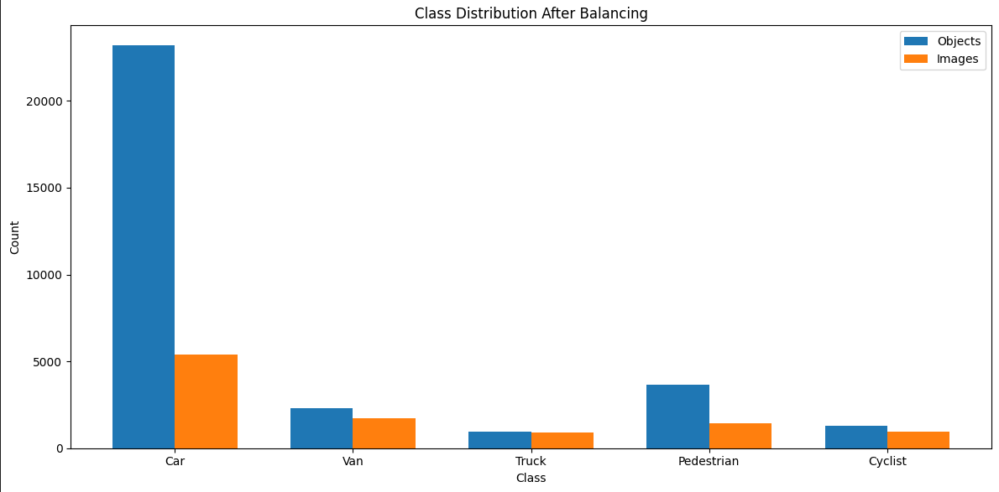
Data after processing

Slide 13
03
Milestone 2 Object Detection Model Development

Slide 14
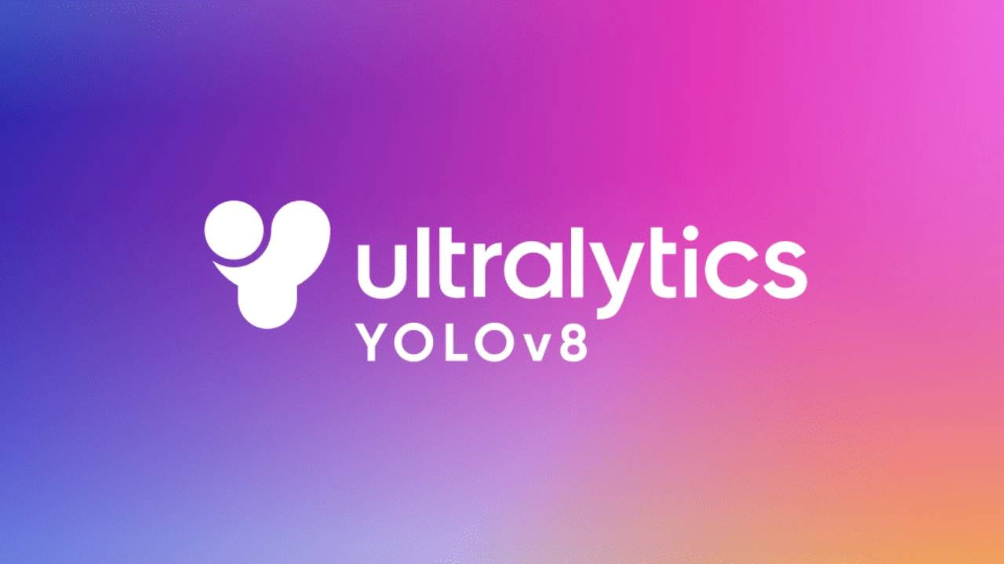
YOLO V8
State-of-the-art real-time object detection
Improved accuracy and speed
Supports detection, segmentation, and classification
Easy training and deployment with Ultralytics
Optimized for ONNX, TensorRT, and mobile devices

Slide 15
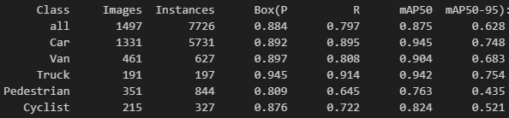
mAP after Training

Slide 16
04
Milestone 2 Deployment and Real-Time Testing

Slide 17

Convert from pt to onnx
Why Convert?!
ONNX (Open Neural Network Exchange) allows models trained in PyTorch to be used in other environments like TensorRT, OpenCV, or mobile/edge devices.
Benefits
Cross-platform compatibility
Optimization support (e.g., TensorRT)
Easy deployment to edge devices

Slide 18

Model Deployment using Streamlit
What is Streamlit?
Streamlit is an open-source Python framework that allows you to quickly turn machine learning models into interactive web applications with minimal code.
Benefits
Fast and easy to build an interactive UI
Requires no front-end experience
Greats for demos , internal tools , and quick prototyping

Slide 19
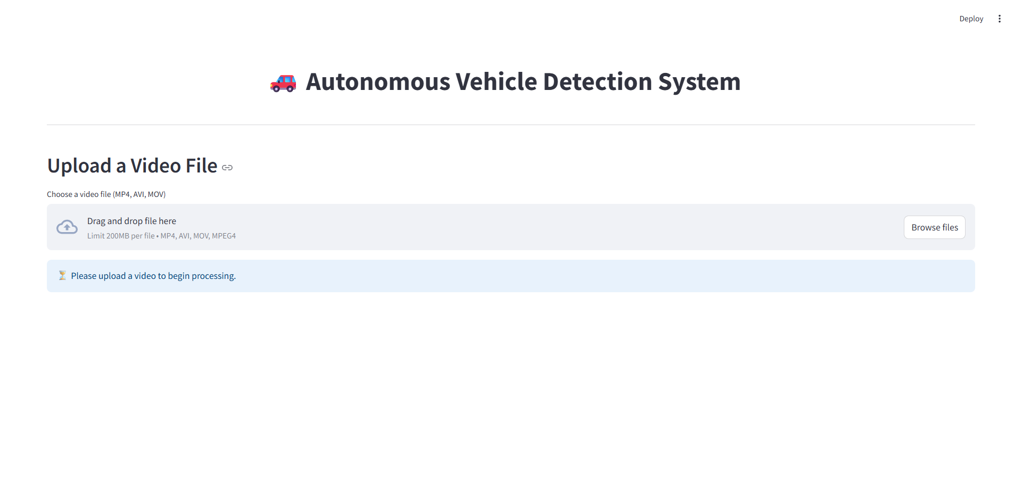
User Interface

Slide 20
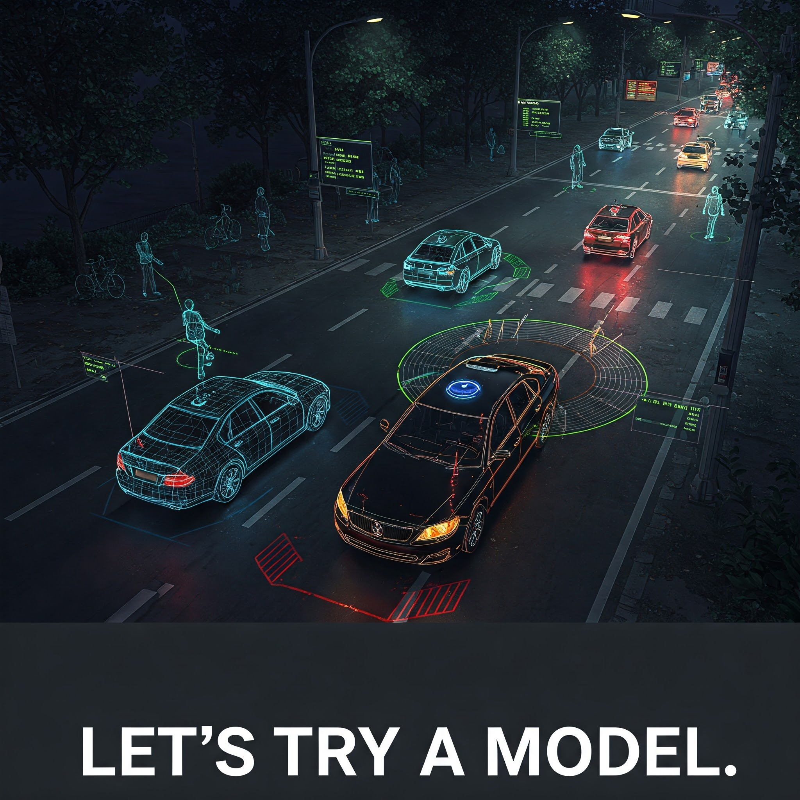
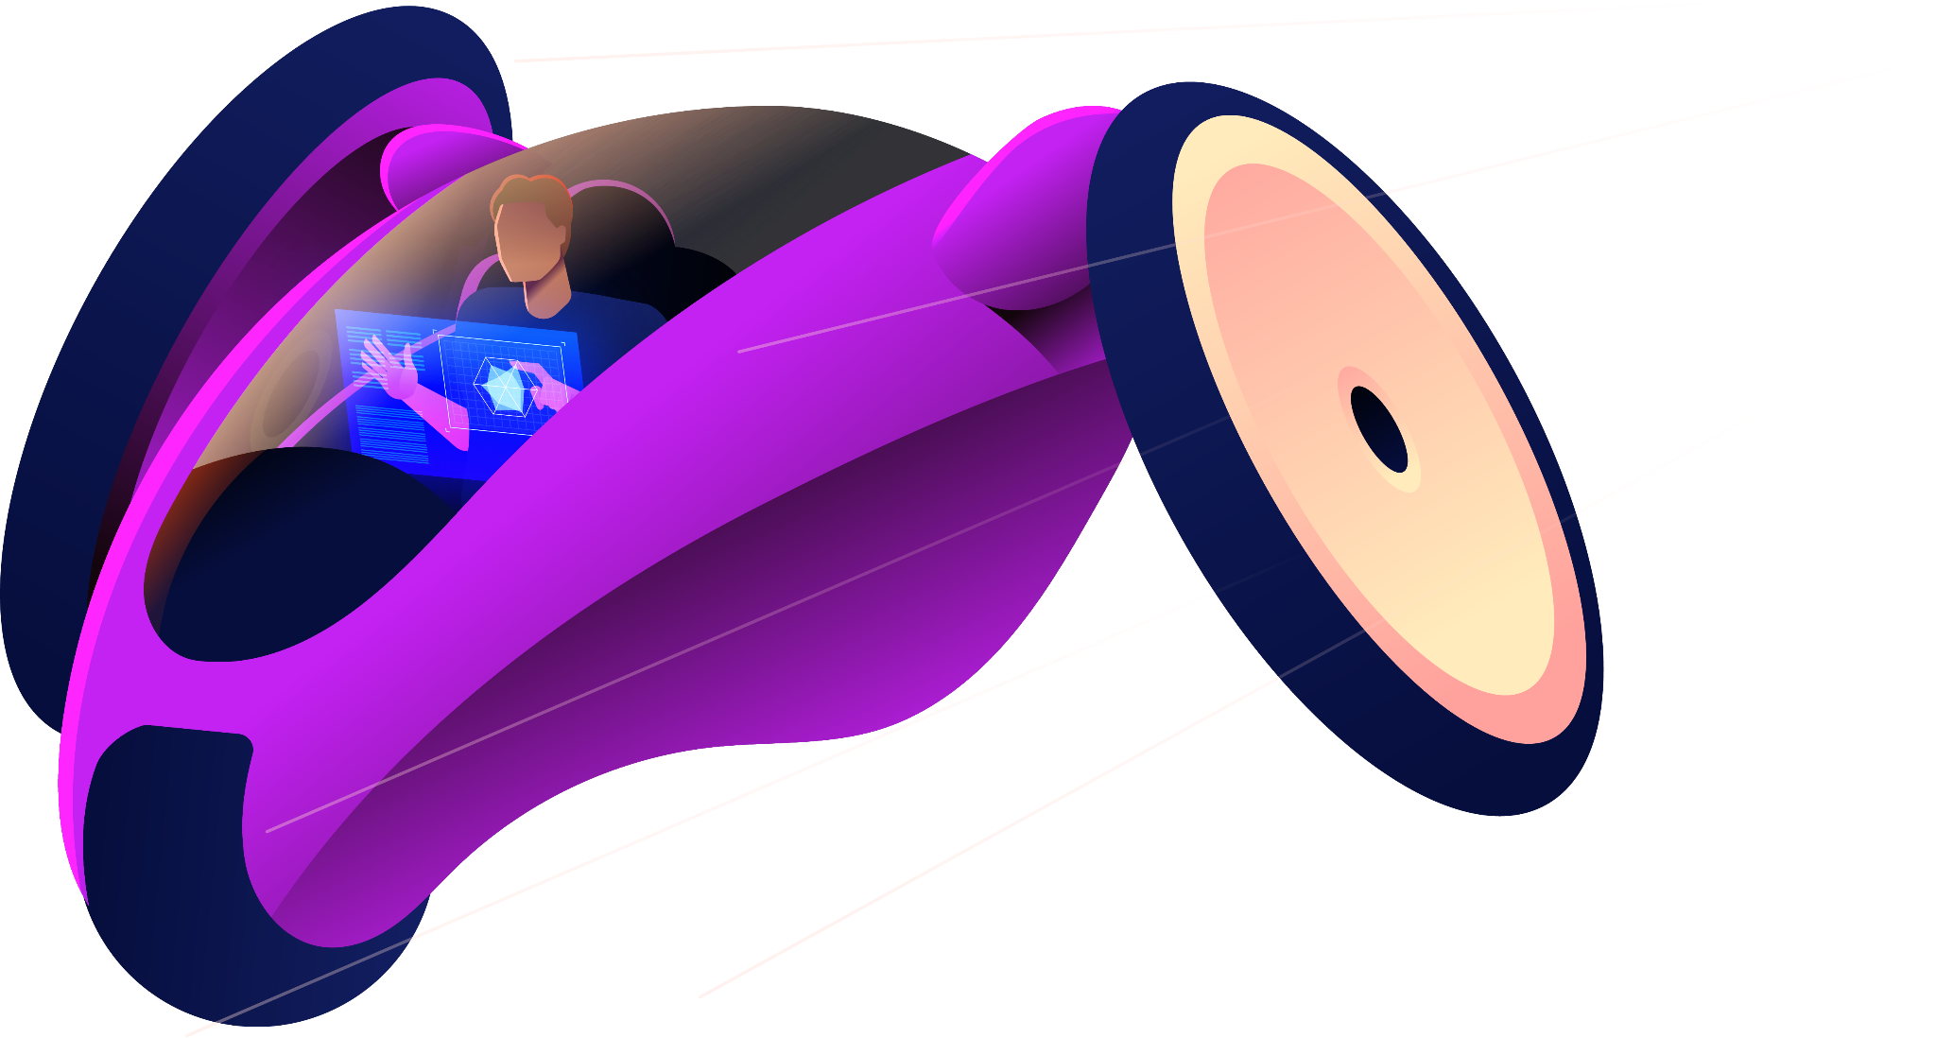

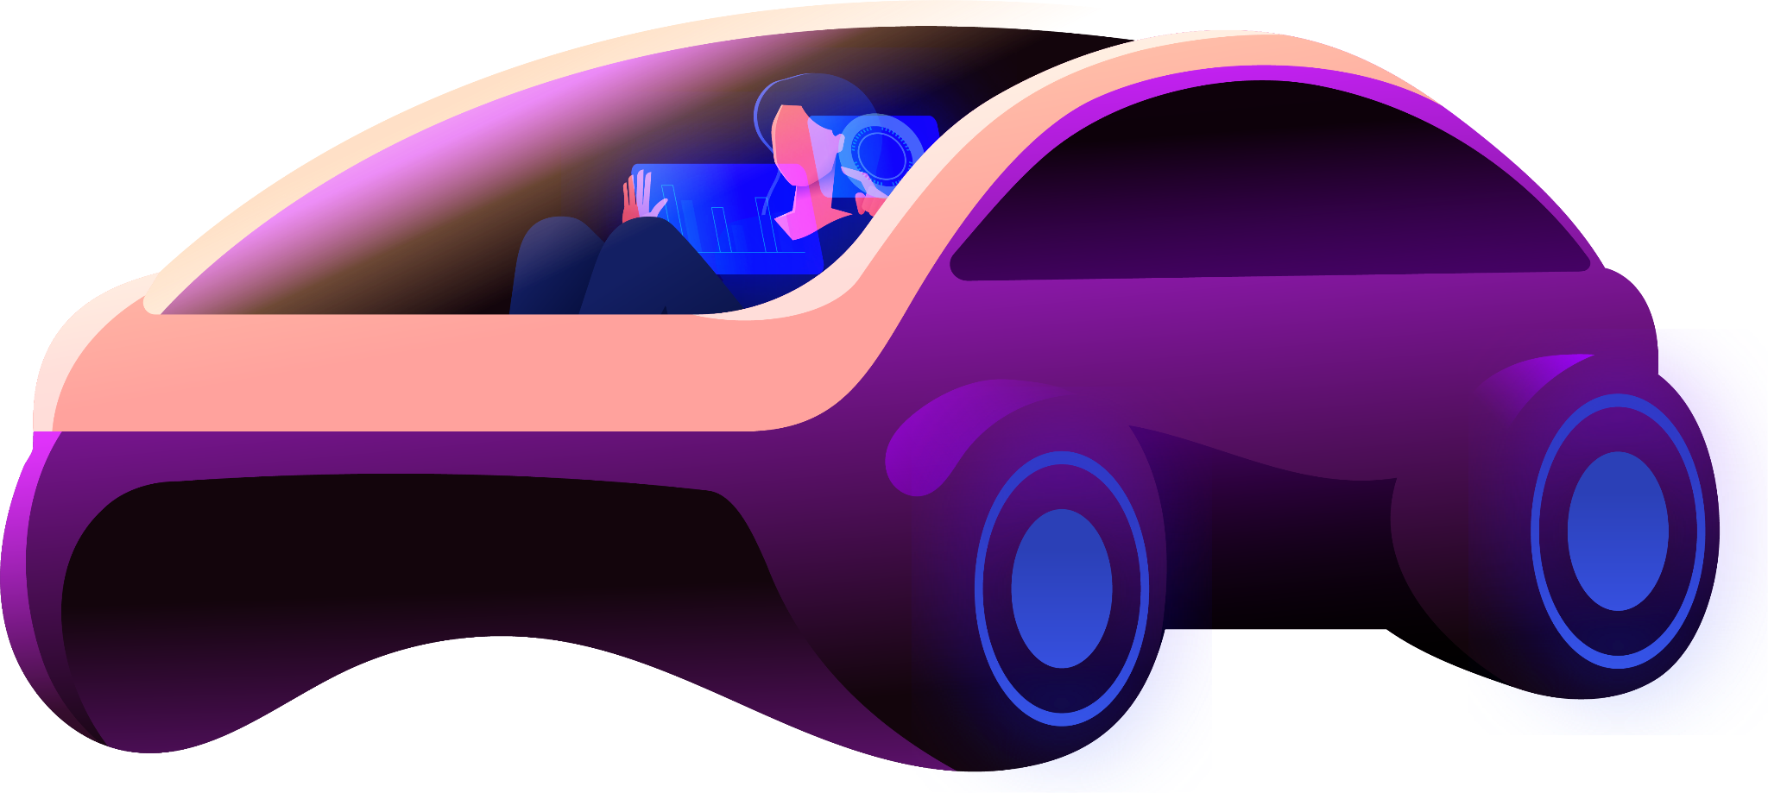

Slide 21
Thanks!

